Slide 1


Why
media integrity matters?
Why systematic anti-corruption engagement is required?
Brankica Petković, Peace Institute, Ljubljana, South East European Media Observatory project coordinator and lead reseacher
This project is funded by the European Union Instrument for Pre-accession Assistance (IPA)
Civil Society Facility (CSF).

Slide 2

South East European Media Observatory?
is a regional partnership of civil society organizations aimed at enhancing media freedom and pluralism, and influencing media reforms in the countries of South East Europe.
connects seven media centers/institutes from Albania, Bosnia and Herzegovina, Croatia, Hungary, Macedonia, Serbia and Slovenia, all being members of the regional network SEENPM (established in 2000)
started in December 2012 with the support of the European Union (DG Enlargement)
Phase 1: two years, until December 2014
Phase 2: 2015-2016 to include also Kosovo, Montenegro and Turkey

Slide 3
SEE Media Observatory
a regional instrument to monitor and research media integrity on regular basis, based on common methodology, producing national reports and regional overviews, and informing reform processes on national and regional level
provides also support (grants) to investigative journalists to investigate and report on corrupt practices and relations in the media system, and support (grants) to other CSOs to advocate for changes
provides national and regional frameworks for exchange and dialogue between key actors (e.g. this anti-corruption meeting)
Web site: http://mediaobservatory.net/

Slide 4
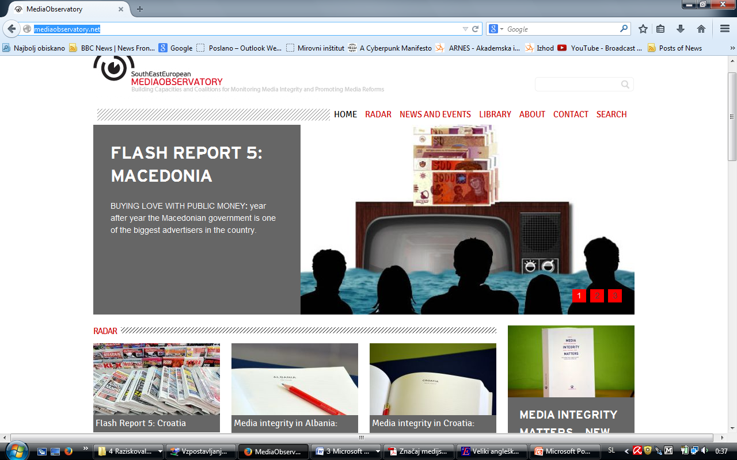
mediaobservatory.net

Slide 5
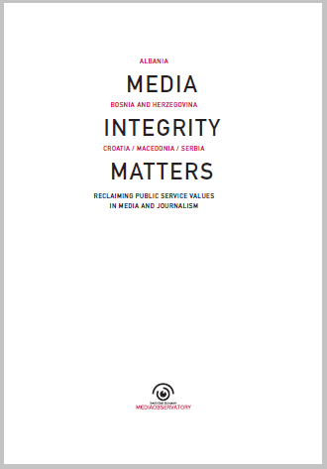
Media integrity matters
recently published (June 2014) volume with the research reports on media integrity in 5 countries of South East Europe: Albania, Bosnia and Herzegovina, Croatia, Macedonia and Serbia, and with a regional overview.

Slide 6
Why “media integrity”?
Why the media (systems) in the countries of our region are as they are, and what influence their ability or disability to serve public interest and democratic processes?
Ten years ago we offered an answer – it is media ownership that matters (see our report Media Ownership and Its Impact on Media Independence and Pluralism from 2004).
Ten years after we still think that media ownership is one of the key issues for providing or obstructing functional democracy. We still think that today’s crucial problems of media and democracy in the countries of our region includes media ownership, but the problem is broader than that.

Slide 7
Why “media integrity”?
The obstructions and disrespect for public interest in the media are result of corrupt relations and practices that are integrated in our media systems.
These corrupt relations and practices, including political clientelism, have been evolving and interplaying to the point of becoming a system on its own.

Slide 8
Why “media integrity”?
We can follow the patterns of corrupt, clientelistic relations and practices in various parts of the media systems – how media policy and media laws are developed and how their implementation is obstructed by undermining independence of media regulators, how media ownership and media finances are hidden from public and abused for particular private and political interests, how public service broadcasters are destabilized and captured by particular interests through governing and financing patterns, how journalists are professionally and economically degraded and disabled from being public service operators, etc.

Slide 9
Why “media integrity”?
At the SEE Media Observatory we see these problems as interconnected - interconnected in a corrupt system which is major problem of media and democracy in our countries, and as such has to be addressed in a systematic way.
We see the burning need to systematically elaborate, develop and defend those qualities of media systems which put media and journalism in the service of public.
Shortly – to defend media integrity.

Slide 10
Media integrity?
With the concept of media integrity introduced in our research we denote public service values in media and journalism.
Our definition of media integrity is elaborated in the research report, as well as a methodology with inventory of more than 60 risks for media integrity.
Those risks are identified across 4 areas:
-media policy,
-media structures (ownership, finances, public service broadcasting),
-journalists/their situation and status, and
-media/journalistic practices.

Slide 11
Media integrity: definition
Media integrity encompasses qualities of the media system – policies, structures and practices in the media field, and their relations – which enable the media to serve public interest and democratic processes, demonstrating in their operations and content:
freedom and independence from particular/special private or governmental interests,
transparency of own operations and interests including clear disclosure of exposure to or dependence upon particular private or governmental interests,
commitment to and respect for ethical and professional standards, and
responsibility and responsiveness to citizens.

Slide 12
Media integrity: definition
Media integrity more specifically refers to:
ability of the media to provide accurate and reliable information to citizens without dependence upon, serving of and clientelistic relations with particular/special private or governmental sources, as well as to
provide citizens with access to and expression of wide range of views and opinions without exposure to bias and propaganda.

Slide 13
Media integrity: definition
Media integrity also integrates:
capacities of journalists and other media professionals to apply professional autonomy and standards, demonstrating commitment to serve public interest against relations and practices which corrupt and instrumentalize the profession for particular/special private or governmental interests. Such journalistic capacities include:
transparency of dependence upon particular interests and sources, and commitment of journalists to protect professional standards in such circumstances.

Slide 14
Media integrity vs. institutional corruption in the media system
Media integrity relates to the notions of media freedom and independence, as well as to media pluralism, but
an analytical category focusing on institutional corruption in the media system, on manifestations of economy of influence and conflicting dependence (Lessig, 2010) in the media sector

Slide 15
Media policy
Media policy interventions not guided by public interest, detected through systematic analysis, public discussions and search for consensus in society what kind of media we want
Laws, concrete rules and measures instrumentalized for political agenda of particular political groups or for concrete benefit of particular private business and political interests
Media industry does not openly play as an actor in media policy, but rather acts in the corridors of power
Attention should be paid to lobbying or “legislative subsidies” granted to those that have formal or informal power to influence leigslative decisions or to affect regulation in specific area
To be able to identify corruption risks in the media field, it is necessary to monitor carefully how media legislation is adopted and to establish which “legislation subsidies” are available to particular media (owners) – Quid pro quo (a favour for a favour)

Slide 16
Media policy
De facto vs. de jure
Weak implementation of media laws – efficient regulation would affect interests which are protected by political groups in power
Regulators – exposed to political pressure, weak, dependent on the government, not given the power to efficiently act, or power is taken from them (e.g. CRA)
Civil sector through which public interest could be articulated weak and with little influence
Lack of policy which would strickly and systematically introduce and implement transparency in all parts of the media system, including ownership and finances of the media, is not an accident, it is a deliberate element of the pervading culture/system of institutional corruption which suits many actors in the media system guided by particular interests

Slide 17
Media ownership
-Media ownership is not transparent. Even when formal owners are known, data on real owners and/or on source of investment are hidden.
Media ownership is not gained for and driven by strategic business interests in the media market, but by political interests to control and use media for promotion of own and disqualification of opposing political agenda, or by particular business groups which use the media in clientelistic relations with political groups (seeking to achieve various “rents” and concessions).

Slide 18
Media finances
Low transparency of data on the financial operations of media business.
Strong dependence on the financial flows involving the state
=Media finances: economic levers in the hands of political lords

Slide 19
Media finances
Consequence of politically motivated distribution of state funds to influence media operation: (ab)use of media as a means of shaping public opinion, boosting political ratings or increasing individual wealth.
The trends are clear. Political parties and politicians, using funds from the state budget, maintain a web of politically affiliated and politically motivated agencies whose owners use a network of a small number of powerful people to establish control over the media sector.
Owing to this hijacking of funds, most of the media are never critical of the state bodies’ operation, except in cases when it suits the interests of certain political parties or a part of the political elite.

Slide 20
Political parties
Funding from political parties
Direct relationship between electoral periods and advertising revenue, indicating the dependence of the media outlets on political funding for their survival.
Rules for transparency of electoral campaigns are not adequate and there are problems with their implementation.
In some countries there are also problems with parties having debts to televisions that broadcast their advertising spots (Albania,) or media are donors to political parties (Macedonia) which raises doubts both on the nature of relationship between political parties and the media, and the financial viability of the media

Slide 21
Advertising
Controversial role of intermediary advertising agencies: politically affiliated, becoming another way of having political influence on the media (e.g. Serbia), where the media is rewarded or punished depending on their political attitude.
Influence of large advertisers on media content or on media silence is evident in most countries, given their significance for the survival of these media.

Slide 22
Journalists?
To be a journalist in Albania, BiH, Croatia, Macedonia and Serbia – the countries covered by our research – today means to be socially degraded to a servant of businessmen, professionally reduced to the “microphone holder” (a term often used by journalists interviewed in our research), and economically reduced to a precarious worker without rights, whose salary is often lower than the national average and sometimes delayed by several months.
Here we have in mind the average journalist’s salary between 250 and 350 euro (except in Croatia, where the wages are higher).

Slide 23
Journalistists
There are hundreds of unemployed journalists in the countries we researched; anyone can become a journalist without having the needed skills and qualifications, and all that is exploited by media owners to reduce labour costs and exert pressure.
In such circumstances of predatory capitalism, ethical issues in journalism are considered a “luxury” by many interviewed journalists, or something that creates a lot of difficulties for them if they persist on ethical standards.
Journalists are threatened, accused and attacked.
Investigative journalists are especially in danger.
Professional and economic degradation, however, did not trigger an organized resistance on the part of journalists.

Slide 24
Journalists
MK: party-political colonial pressure on the media and journalists
There is top-down political engineering in the way the newsrooms are being cleaned from real journalists
Culture of “podobnost” (eligibility) in relations between political actors and journalists
Government using judicial system to maintain a grip on journalists (number of lawsuits...)
Role of the editors: “brokers” in clientelistic chain, censoring and disregarding journalistic content to protect the interests of patrons; distrust and disconnection between editors and journalists, insecurity of jobs for both

Slide 25
Journalistic/media practices
In terms of content, the mainstream journalism has practically completely succumbed to instrumentalisation for commercial purposes and political parallelism.

Slide 26
Why a systematic anti-corruption engagement is required?
The fundamental thesis of our analysis is that media which do not serve the interests of the public are – corrupt.
In saying so, we do not have in mind any specific media outlet or a specific journalistic practice but rather the media systems within which these media operate.
Democracy rests on freedom of expression, freedom of speech and media freedom.
Corrupt media spell the death for democracy. They are a deeply undemocratic institution that transforms the state into a private company.

Slide 27
Why a systematic anti-corruption engagement is required?
Fight against corruption in the media, including the exposure of non-transparent ownership relations and funding methods and a critique of the fall of journalism as a practice of public control over the operation of governmental institutions, is simultaneously a fight for democracy.

Slide 28
Why a systematic anti-corruption engagement is required?
Who owns the problem? Who should engage in solving it?
We see the role of independent state bodies – anti-corruption bodies, information commissioners, ombudsman, courts of audit... – established within the system to protect fundamental rights of citizens, to protect rule of law and public interest.
Role of journalists?
Role of citizens? Citizenship as a public service employment. How to mobilize citizens for fight against corruption in the media/fight for better media?
How to build alliances for media integrity?

Slide 29
In conclusion
It is necessary to make an environment for media operation that would enable the media to break the dependence on private centres of power and become dependent on the public.
To attain this goal it is necessary to challenge the existing management, funding and ownership models in the media sector.

Slide 30
In conclusion
The issues we are raising are not problem only of the region of South East Europe, it is broader, and global. We can safely argue that, at the moment, there does not exist an effective mechanism for the protection of citizens' right to receive quality and credible information, neither on the national nor on the supra-national (EU) level.
Our efforts to reclaim public service values in media and journalism, to promote and protect integrity of the media in the countries of South East Europe are not isolated from other media reform movements in Europe and around the world.

