Slide 1


Public service broadcasting: governing and financing patterns
- way of control and way of solution?
Dubravka Valić Nedeljković, Novi Sad School of Journalism, co-author of the media integrity research report for Serbia
Central regional conference, 12-13 June 2014, Tirana, Albania
This project is funded by the European Union Instrument for Pre-accession Assistance (IPA)
Civil Society Facility (CSF).

Slide 2

Regional overview
(authors: Brankica Petković and Sandra Bašić Hrvatin)
Public service broadcasters remain the part of the media system that is most exposed to risks when it comes to particular political interests and prevention of independent operation in the service of society as a whole.
This project is funded by the European Union Instrument for Pre-accession Assistance (IPA)
Civil Society Facility (CSF).

Slide 3
The PSB management and funding system are arbitrarily determined and changed by political players:
An example is the latest, 2012 amendment to the Croatian Radio and Television Act, which came after the change of governmentit entrusted the appointment of a PSB director to the Parliament.
This project is funded by the European Union Instrument for Pre-accession Assistance (IPA)
Civil Society Facility (CSF).

Slide 4
The PSB management and funding system are arbitrarily determined and changed by political players:
In Macedonia, every government up to the present day had its own people in the leading position within the PSB.
The new Albanian government that came to power in 2013. immediately announced reform of the PSB.
This project is funded by the European Union Instrument for Pre-accession Assistance (IPA)
Civil Society Facility (CSF).

Slide 5
Laws in all of these countries stipulate that positions in the management and supervisory bodies of public services should be occupied by competent representatives of various segments of the public and civil societies
IN PRACTICE
these bodies are mainly composed of people with clear political profiles loyal to individual political parties.
This project is funded by the European Union Instrument for Pre-accession Assistance (IPA)
Civil Society Facility (CSF).

Slide 6



In BiH, the appointment procedure takes into account ethnic membership in addition to political affiliations, while candidates’ skills and experiences are irrelevant.
This project is funded by the European Union Instrument for Pre-accession Assistance (IPA)
Civil Society Facility (CSF).

Slide 7


In Albania, a PSB regulatory body is fully passive
In Macedonia, the role of the Council is rather ceremonial.
This project is funded by the European Union Instrument for Pre-accession Assistance (IPA)
Civil Society Facility (CSF).

Slide 8


In Serbia’s public service, the General Director was for a long time more influential than the Governing Board.
In Croatia, the Supervisory Board, owing to conflict of interests.
This project is funded by the European Union Instrument for Pre-accession Assistance (IPA)
Civil Society Facility (CSF).

Slide 9
Information on finances and business activities of PSBs is difficult to access.
The largest public service broadcasters in the region, the PSBs of Serbia and Croatia, operate with a loss.
- The laws that regulate public service broadcasters seem to be designed to keep PSBs hostages of the governments.
This project is funded by the European Union Instrument for Pre-accession Assistance (IPA)
Civil Society Facility (CSF).

Slide 10
The operation of PSBs’ management and supervisory boards is mainly completely intransparent.
The organizational structure of public services is complex to the point of unmanageability.
In many cases PSBs are the largest employers in the media sector, with big budgets, production capacities and ramified infrastructure.
This project is funded by the European Union Instrument for Pre-accession Assistance (IPA)
Civil Society Facility (CSF).

Slide 11
The analysis showed that what is involved is a long lasting and deliberate obstruction of public broadcasters’ transparent, independent and stable operation, through the actions of governments as well as supervisory boards and managements.
This project is funded by the European Union Instrument for Pre-accession Assistance (IPA)
Civil Society Facility (CSF).

Slide 12









Public service broadcasting : governing and financing patterns - way of control and way of solution?
Case of Serbia
Dr. Jovanka Matić
Prof. Dr. Dubravka Valić Nedeljković

Slide 13
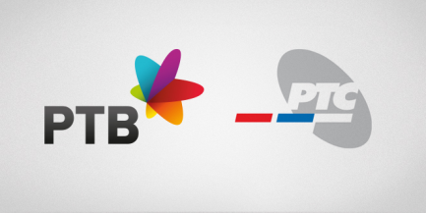
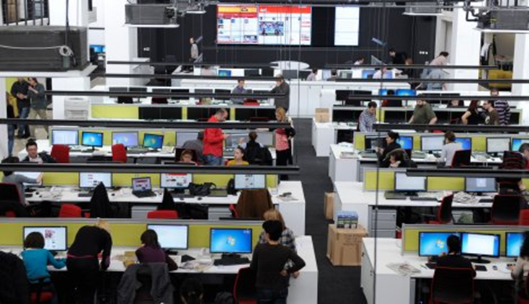
Introduction
The concept of public service broadcasting was defined in 2002 by the Broadcasting Law, which stipulated the transformation of the former state-run broadcaster RTS into two equal public broadcasters:
a national RTS
a provincial one RTV.
12

Slide 14
Introduction
They were designed in the same way, resting on a license fee funding system in order to avoid the dependence on the state.
.
The Public Service Broadcasting Institution of Serbia (RTS) and
Public Service Broadcasting Institution of Vojvodina (RTV)
were formally inaugurated in 2006.
13

Slide 15
Introduction
Their tasks and
programming obligations
are the same.
.
In addition the provincial broadcaster (RTV) having an emphasized role in serving numerous ethnic minorities living in Vojvodina, broadcasting programme in 10 languages.
14

Slide 16
Introduction
Public service broadcasting has managed to become a unique and popular media institution.
BUT
In 2013 it became obvious that the very institution of public service broadcasting is in crisis.
Both RTS and RTV were on a verge of a financial collapse.
15

Slide 17

Political pressures on the programming came to the fore, along with other unresolved issues
a too large staff, inadequate personnel policy
a privileged position of RTS over RTV
and television
compared to radio
non-transparent decision-making
RTS and RTV
A short or long-termrisis?
low programming diversity
Instable finances and lack of transparency and accountability of public service broadcasters require urgent solutions.
16

Slide 18
Incomplete regulation
Programming requirements are not defined
was
deficientfrom the
very beginning
Regulation of the collection
of license feesis
too deficient to
be effectively ex ercised
Do
not provide a clear
definition
of the public interest
The law does not stipulate mechanisms for transparency of financing and business operations of RTS and RTV or procedures for accountability and control of the financial and programming policy.
17

Slide 19


Incomplete regulation
2011 Media Strategy provided a new impetus for legislative changes, stipulating that deficiencies of the public service broadcasting concept will be corrected in a new Law on Electronic Media.
Guarantees of editorial independence of public service broadcasters were not established either in the law or in their internal acts.
These indicate a lack of political consensus on the regulation of public service broadcasting.
18

Slide 20

Lack of financial sustainability
The incom of media agencies BLOCK & CONNECT (miliona RSD)
+4.445 %
There are no public documents from later years that show the shares of license fees and advertising in the revenues of RTS and the way they are spent.
Incomes of the Block @ Connect media agency have increased for 4445 percent since the party to wich they are close gained power.
Monopolistic position of advertising agencies that closly connected with government reduces the competitivness of the media
19
Izvor: Agencija za privredne registre Republike Srbije

Slide 21

Both RTS and RTV have operated with a loss for many years.
In 2012, by official balance sheets:
RTS recorded the loss of about 11 million euro
RTV was 1.3 million euro in the red.
According to RTS Director General media statements, RTS needs about 100 million euro annually for normal functioning, while in 2013 it disposed with 66 million.
20
;

Slide 22
Both RTS and RTV have operated with a loss for many years.
In 2012, by official balance sheets:
During 2013, RTS was supported with 200 million dinars budget funds a month,
which covered only part of its expenses.
21
;

Slide 23
Both RTS and RTV have operated with a loss for many years.
In 2012, by official balance sheets:
RTV was in an especially difficult financial situation during 2013. Underfunded by license fees, it was left without any financial support for 18 months, which in August 2013 led its Governing Board to announce it would be forced to stop airing the programming. The solution was found in an urgent financial intervention from the budget.
22
;

Slide 24



The income from license fees decreased for a variety of reasons:
a poorly regulated, non-transparent and inefficient collection system.
Financial instability of public service broadcasters also has roots in their non-transparent commercial operations.
The collection rate started dropping after the 2008 economic recession, when it was below 50 percent.
the impoverishment of the population
Public service broadcasting has been in a search of a new solution for the problem of funding for a long time.
23

Slide 25

Non-transparent and irresponsible management
RTS journalists describe its management as non-transparent, irresponsible and inappropriate for meeting the public service remit.
The lack of management transparency is the consequence of inadequate regulation, which does not specify clearly the competencies and supervision of the highest governing body,
the Governing Board, and sets unclear and superficial criteria for member selection.

Slide 26
Non-transparent and irresponsible management
RTV saw four replacements of its general director since its formal transformation in 2006.
According to focus group participants, “each appointed its own team, and employed new personnel in already overstaffed and inefficient broadcaster.”

Slide 27
Non-transparent and irresponsible management
RTS employees know very little about their actions, ideas or interests they represent, but it is clear to them that the Board members are not accountable to anyone. They share the opinion that members of the Board protect some particular (especially political) interests and influence the appointment of other responsible people who are also close to certain political forces.

Slide 28
Non-transparent and irresponsible management
RTV
Constant reorganizations resulted in more harm that improvement in the efficiency of the production process.
RTS
A positive practice of RTS is that it is careful not to put the programming in the service of specific commercial interests.
It has very strict standards for the avoidance of direct or hidden advertising and forbids favouring of certain products or manufacturers over others.

Slide 29
Regional overview: Conclusion
It is clear that
stable funding from license fees,
the appointment of independent,
credible and competent supervisors and
    skilled and upright executives
This project is funded by the European Union Instrument for Pre-accession Assistance (IPA)
Civil Society Facility (CSF).

Slide 30
Regional overview: Conclusion
could turn these media into
transparent institutions committed to public service, and
that they could become the best employers
for best journalists and
other programming and
technical personnel
who could produce
truly public service content.
This project is funded by the European Union Instrument for Pre-accession Assistance (IPA)
Civil Society Facility (CSF).

