Slide 1

SUPERVIZOR
Providing citizens with information about the government spending http://supervizor.kpk-rs.si
Matjaž Mešnjak
Komisija za preprečevanje korupcije
Dunajska 56, Ljubljana t +386 1 400 57 10 f +386 1 478 84 72 www.kpk-rs.si

Slide 2
Project Transparency
Transparency of financial flows between the public and the private sector increases the level of responsibilities of public office holders for effective and efficient use of public finance, facilitates debate on adopted and planned investments and projects as well as decreases risks for illicit management, abuse of functions, and above all, limits systemic corruption, unfair competition and clientage in public procurement procedures.
In 2011 the Commission for the Prevention of Corruption (CPC) started a project called Transparency. An important part of this project is the application Supervizor, an online application for monitoring expenses of public sector entities.

Slide 3
Supervizor
Supervizor is an online application which enables simple browsing through the financial transactions and their graphical presentation.
User can view all money transfers from selected budget user or all money transfers from the budget user to selected company.
Data can also be presented for a specified period of time. For all transactions over 2000 EUR the purpose of money transfers is shown.
Notes:
Similar applications are Indiana Transparency Portal, which has a database of all contracts online and Fair Play Alliance in Slovakia.

Slide 4
Supervizor
Application also shows data about public procurements and information about the business entities in Slovenia.
Management and ownership structure of the companies and some information from their annual reports are also presented.
Important part of the application is a module which presents a list of public owned companies and information about them.
For direct budget users Supervizor displays also accounting entries of payments.
Supervizor presents also some other additional data (e.g.: data about tax debtors and transfers to the so called favorable tax environments („tax havens“).
Notes:
So let’s take a look at the datasets that we incorporate into the application

Slide 5
Datasets
Public Payments Administration (PPA) is providing payment services for direct and indirect budget users. Supervizor includes PPA data about financial transactions of budget users from 1 January 2003 onwards.
AJPES (The Agency of the Republic of Slovenia for Public Legal Records and Related Services) provides and manages:
  ePRS Slovenian Business Register (central public database on all business and legal entities, their subsidiaries, and other organizations‘ segments located in Slovenia (public and private institutes));
  eRTR - Register of legal entity‘s bank accounts;
  JOLP – the public posting of annual reports allowing users to review annual reports which are submitted to AJPES.
Notes:
In Slovenia all payments of the public sector bodies – direct and indirect budget users (bodies of the legislative, judicial and executive branch, autonomous and independent state bodies, local communities and their parts with legal personality, public institutes, public funds, public agencies etc.) are performed through the Public Payments Administration. Public Payments Administration is providing payment services for direct and indirect budget users. The CPC received data about financial transactions of budget users and performed analysis of them.
The Agency of the Republic of Slovenia for Public Legal Records and Related Services (AJPES) is an indispensable primary source of official public and other information on business entities in Slovenia. Slovenian Business Register AJPES manages the Slovenian Business Register as a central public database on all business entities, their subsidiaries, and other organizations‘ segments located in Slovenia which perform profitable or non-profitable activities. A constituent part of the business register is the court register, which includes legal entities (companies and their subsidiaries, subsidiaries of foreign companies, co-operatives, public and private institutes, public agencies and other legal entities).
In Slovenia, companies (including banks, insurance companies, investment funds and co-operatives), sole proprietors, legal entities governed by public law, non-profit organizations, and associations have to present their annual reports to AJPES for the purpose of presenting them publicly and for tax and statistical purposes. Annual reports are available on the internet.

Slide 6
Datasets
Database of securities from Central Securities Clearing Corporation.
Registry of taxpayers.
RPU - Registry of budget users.
Database of public procurements including small value procurements (published on a portal of public procurements).
Accounting entries of payments for direct budget users from MFERAC database maintained by the Slovenian Ministry of Finance (from 1. 1. 2003).
Notes:
The Official Gazette maintains a public database of all public procurements and procurements of a small value.

Slide 7
Datasets
Data about tax debtors (published on the internet by the Tax Administration of Republic of Slovenia).
Data about financial transfers to the so-called favorable tax environments („tax havens“), published on the internet by the Office for Money Laundering Prevention.

Slide 8
SUPERVIZOR OVERVIEW
[http://supervizor.kpk-rs.si]

Slide 9
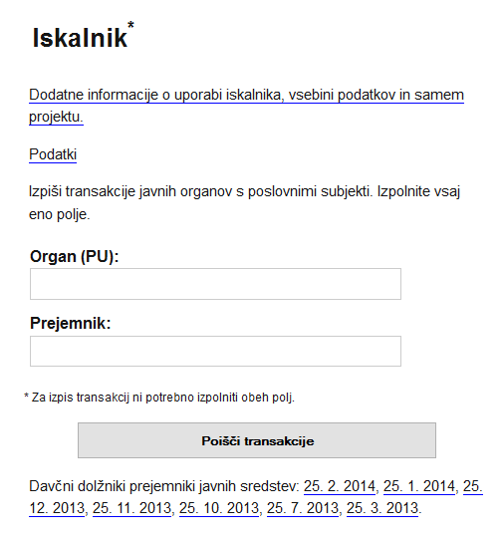
Searching the Supervisor database
events: public procurements (green), events in a business entity (red),..
Copy of data is available for download in machine readable form
subsidiaries
User can enter the name of the budget user…
…or a legal entity (company), or both
structure of payers
A list of tax debtors which are receiving funds from public sector at the time when they have an outstanding tax debt
http://supervizor.kpk-rs.si

Slide 10
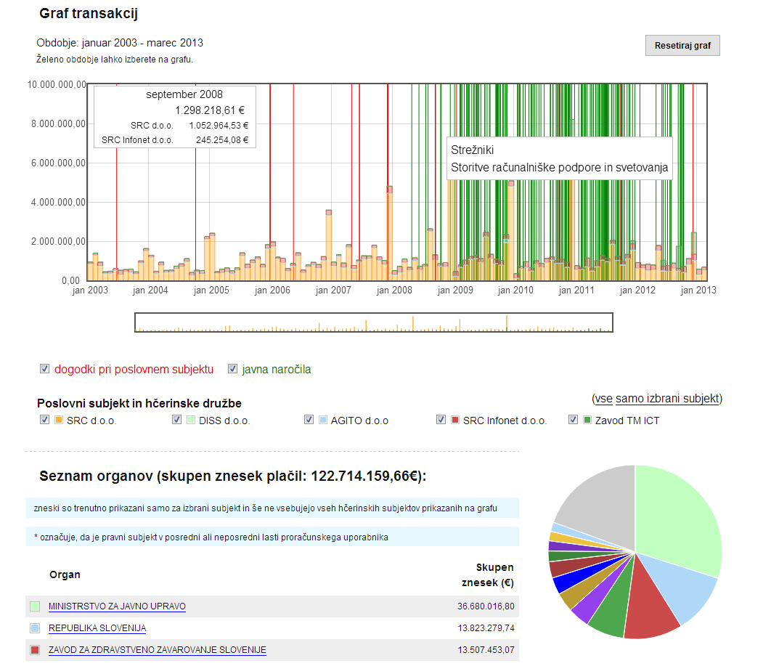
Financial flow analysis
Events: public procurements (green), events in a business entity (red),..
Public procurements and other business events;
Payments to a selected company and its subsidiaries;
Structure of clients from public sector (pie chart);
User can select custom period.
Subsidiaries
Structure of payers
http://supervizor.kpk-rs.si
Notes:
Show: user can select period to analyse.

Slide 11
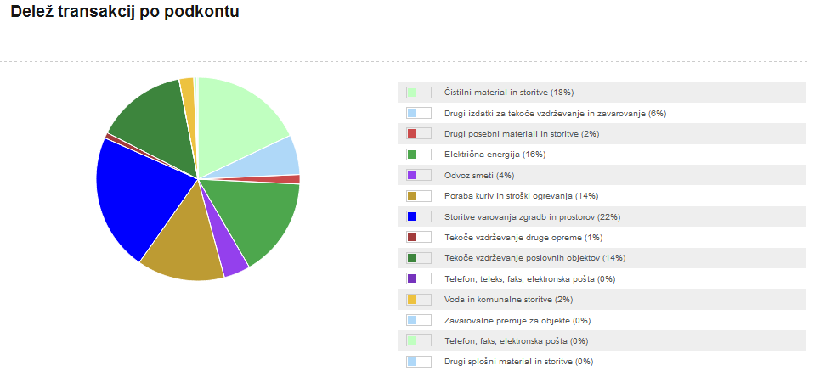
Structure of spending (based on accounting entries)
Example of expenses:
- Electricity
- Waste
- Fuel and heating
- Protection of building
- …
Information on the purpose of transactions derives from the budget accounts database
http://supervizor.kpk-rs.si

Slide 12
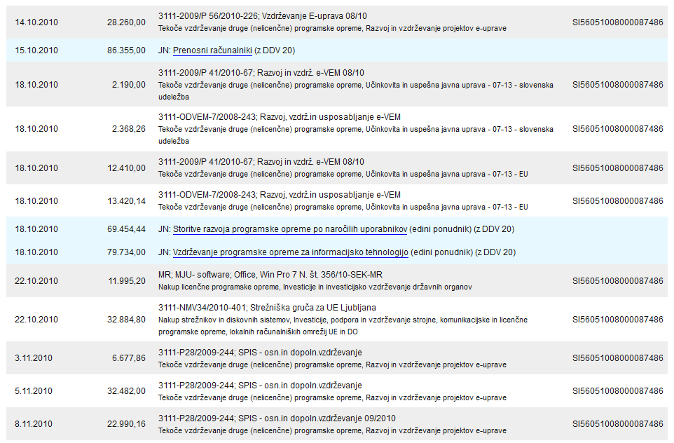
Details about transactions over 2.000 EUR
Bank account of a company
Date and amount of transaction (in EUR)
Public procurements granted to the selected company
Description taken from the budget account and budget item
http://supervizor.kpk-rs.si

Slide 13
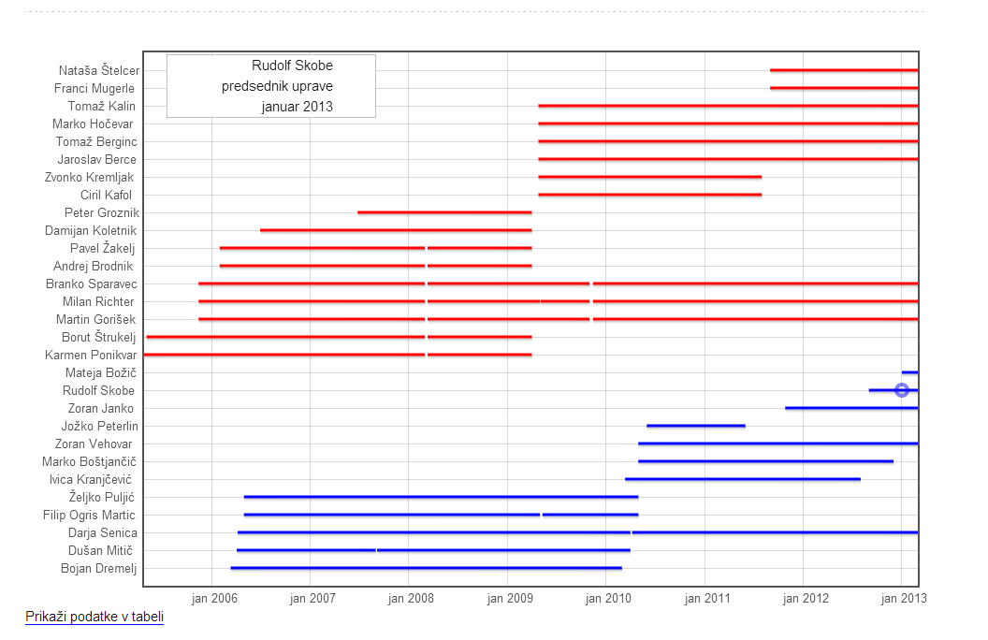
Management and supervisory structure of the companies
Members of the supervisory board
Management structure
http://supervizor.kpk-rs.si

Slide 14
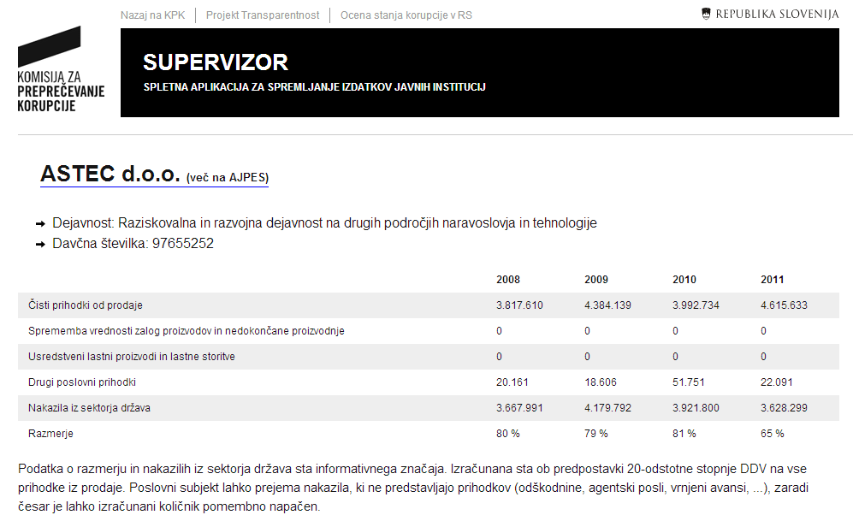
Dependence from public sector
Company, link to business registry, its activity and tax number
Data from annual reports
Net revenue from sales
Transfers from government
Estimated ratio
Data from annual reports combined with data from database of public sector payments.

Slide 15
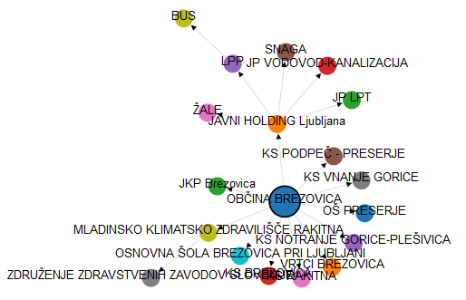
Visualisation of ownership and founder relationships

Slide 16
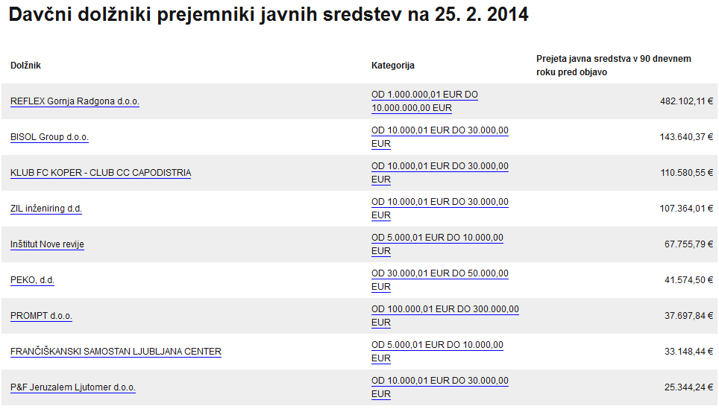
Tax debtors receiving funds from public sector
The amount of received payments from public sector
Category of the debt amout
Data about tax debtors is published monthly on the internet by the Tax administration of the Republic of Slovenia. There companies are listed which have their payments delayed for 90 days.
This data is imported in the Supervizor‘s database and a list of tax debtors which are also receiving funds from public sector at the time they have an outstanding tax debt (90 days before they were published on Tax administration‘s list) is created.

Slide 17
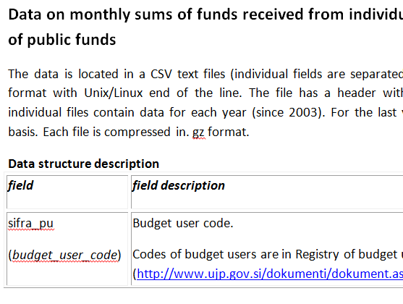
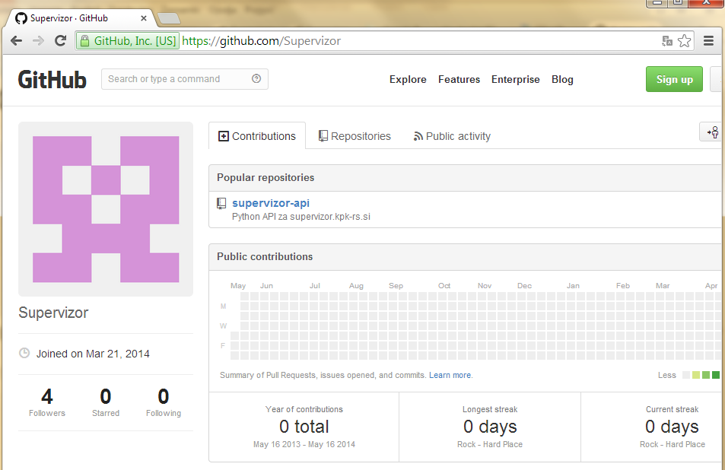
Open Data
Part of Supervizor data is available for download in machine readable form.
Description of data is also available.
API interface to the Supervizor application is also provided.
http://supervizor.kpk-rs.si

Slide 18
Matjaž Mešnjak matjaz.mesnjak@kpk-rs.si
Notes:
In 2014, the Slovenian Parliament passed amendments to the Acces to Public Information Act, which require publishing the data about financial transactions (payments) performed by all companies in 100% ownership of the public sector. This data will be freely available on the internet and the CPC plans to include it also in the Supervizor.
Accounting entries of payments for direct budget users from MFERAC database also include ID numbers of documents that were basis for expenditures e.g.: electronic or scanned invoices or scanned contracts. Some budget users do not have digital copies of their invoices or contracts, but for those which do have them, it could be technically possible to publish those documents on the internet and correlate them with the individual transactions.

