Slide 1
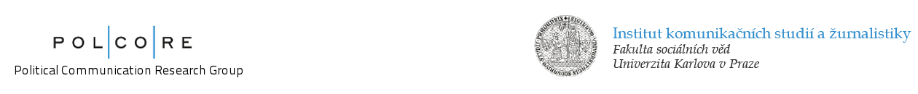
Media ownership in CEE: a brief look at trends and challenges
Dr. Václav Štětka
Institute of Communication Studies and Journalism,
Charles University in Prague
Presentation for the conference
“Media and journalism in South East Europe –
Captured by particular interests or turning to serve the public?”
Tirana, 12-13 June 2014

Slide 2


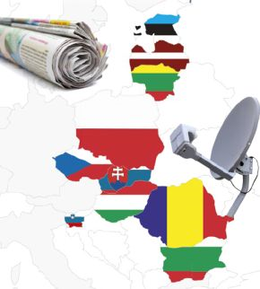
Media and Democracy in Central and Eastern Europe (2009-2013)
10 new EU post-communist member states
Focusing at news media: broadcast, print, online
Investigating the relationship between quality of democracy and quality of media in countries of CEE
Methodology:
  semi-structured elite and expert interviews (over 300)
  document and secondary data analysis
  data modelling
http://mde.politics.ox.ac.uk
Notes:
So first a few words about the project

Slide 3
Main trends in media ownership in CEE
Diminishing presence of Western ownership, following the 2008/09 economic crisis
  Wave of departures of foreign owners from most CEE markets; “de-Westernization of media ownership”
Rise of specific type of media ownership – local business tycoon / oligarch investing into news media
  Increasing intertwinement of media, business and politics; media becoming less autonomous
  Czech Republic: Andrej Babiš – businessman, billionaire -> since 2011 leader of new political party –> since 2013 media mogul -> since 2013 Deputy Prime Minister
Growing practices of instrumentalization of media by the (new) owners to promote their business/political interests
Commercial media weakened by the crisis, by declining readership, by audience/market fragmentation

Slide 4
Western-style media business model is becoming an exception rather than a rule in most CEE countries; media investment as a political strategy (not for business/profit)
  Transition from seeking profit to seeking influence
Old commercial models are failing; new ones have not been found yet
Challenge: ensuring sustainability & independence of quality journalism
Quality/investigative journalism often forced to seek refuge outside of the scope of market economy
  Public service media (wherever still relevant)
  Foundation- or community-based online outlets
Hope: the audience?!

Slide 5
Thank you!
stetka@fsv.cuni.cz
http://www.polcore.cz

